Slide 1
Coronavirus Dashboard on R Shiny
- By Karan Sehgal

Slide 2
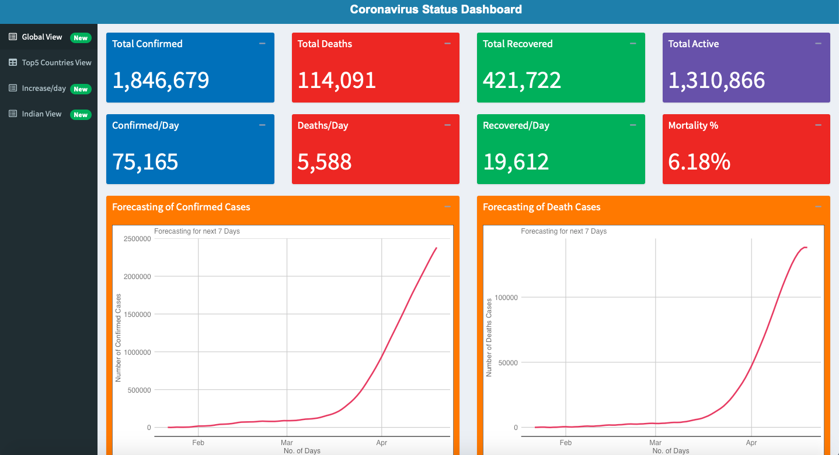
Tab 1

Slide 3
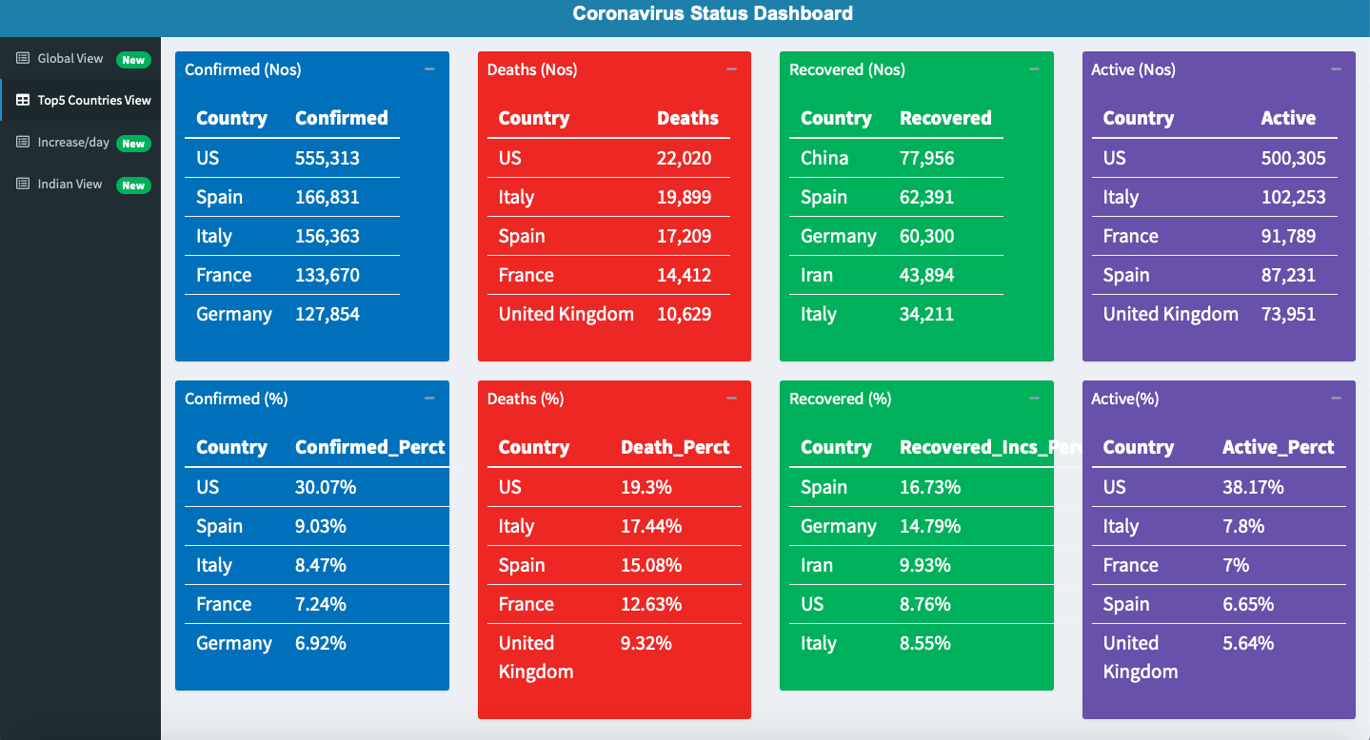
Tab 2

Slide 4
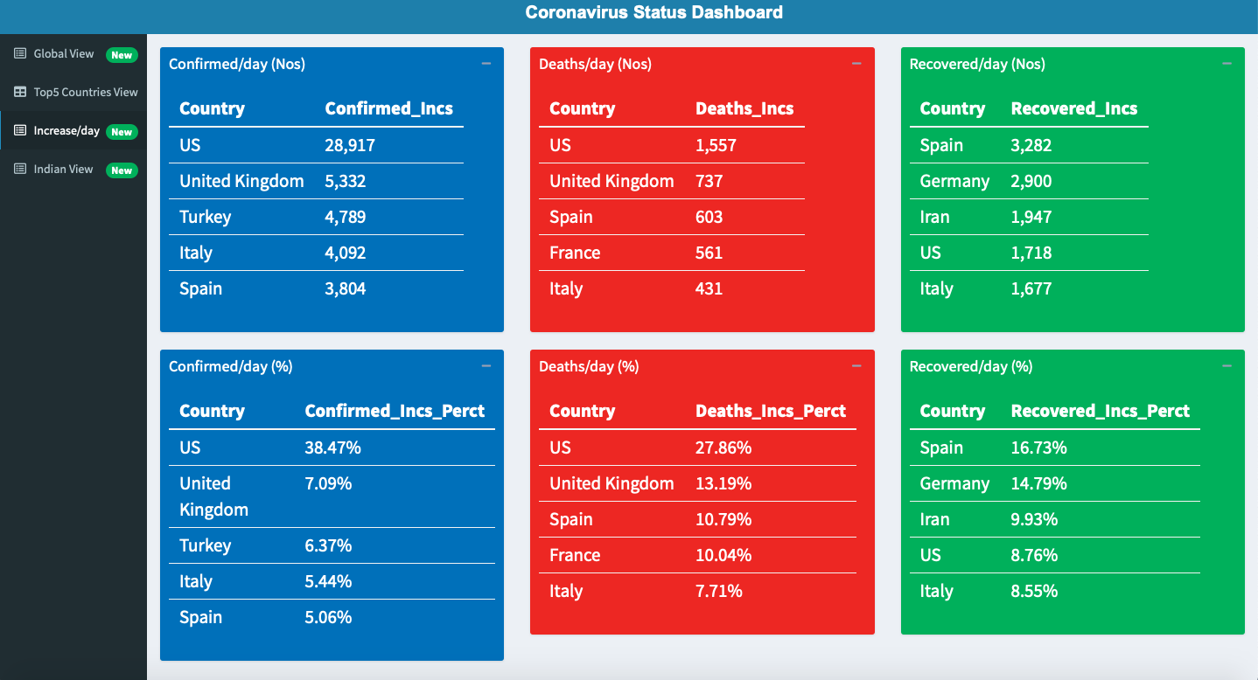
Tab 3

Slide 5
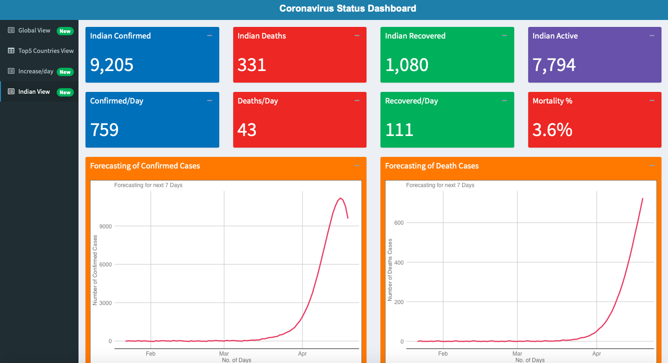
Tab 4

